Slide 1

An Accessible Open-Source Implementation of the Congruent Matching Cells Algorithms for Cartridge Case Analysis
11:05-11:20 D38
Joseph Zemmels, Susan Vanderplas, Heike Hofmann

Slide 2
Overview
Cartridge case analysis
Algorithms & open-source code
The Congruent Matching Cells (CMC) pipeline
The cmcR package
CMC pipeline experimentation

Slide 3
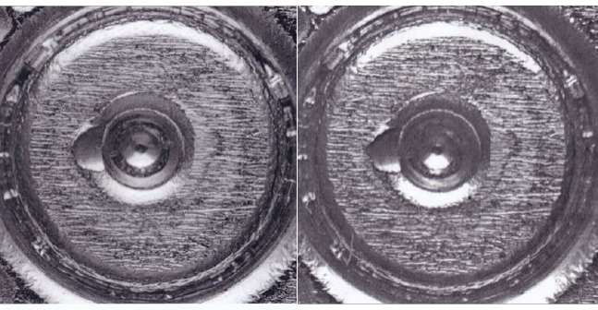
Cartridge Case Analysis
Notes:
I’m sure everyone in the audience is well-aware of cartridge case analysis.
However, to make sure we’re all on the same page

Slide 4
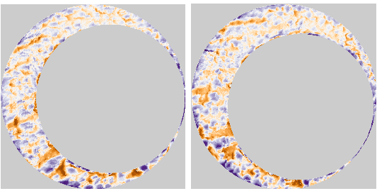
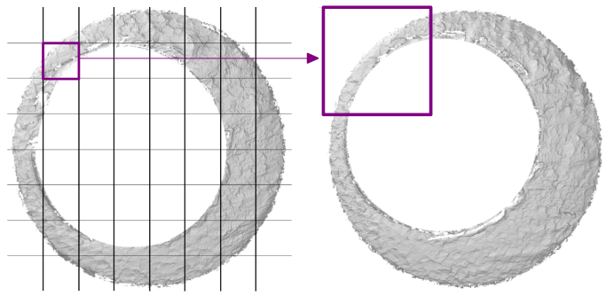
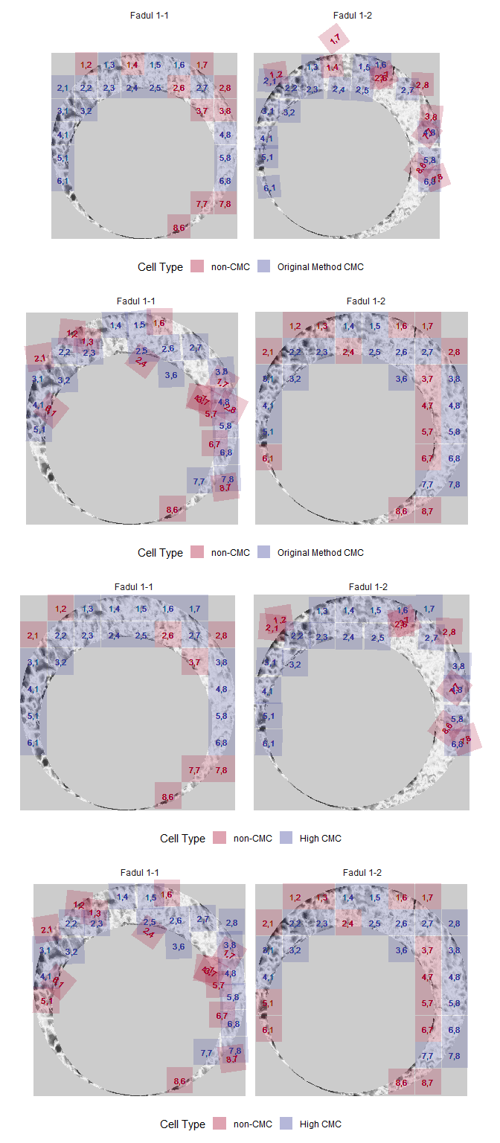
Algorithms as Data-to-Results Pipelines
Algorithm: A set of instructions used to perform a computation.
Each instruction can be thought of as a step in an overall pipeline
Can be used to compute the similarity between pieces of evidence
Initial Data
Pre-processing
Comparison
Final Results
Notes:
For cartridge case analysis, the standard “pipeline” goes something like what is shown on the bottom of the slide.

Slide 5
What are Open-Source Algorithms?
Code is freely available for investigation and experimentation
Open-source algorithms encourage reproducibility of results
Reproducibility
“Obtaining consistent computational results using the same input data, computational steps, methods, code, and conditions of analysis.” (NASEM, 2019)
Reproduction of results is required to establish error rates, etc.

Slide 6

The Congruent Matching Cells Algorithms
Developed at NIST in 2013 with additional changes/improvements since.
Divide one scan into a grid of “cells”
Compare each cell to another cartridge case
Classify cells as “congruent matching” if they match the other scan
Measure similarity as the total number of “Congruent Matching Cells” (CMCs)

Slide 7
The cmcR package
Modularizes the CMC method into an explicit pipeline:
Initial Data %>% First Function %>% Second Function %>% ...
Created using the R statistical programming language
Available for free on the Comprehensive R Archive Network

Slide 8
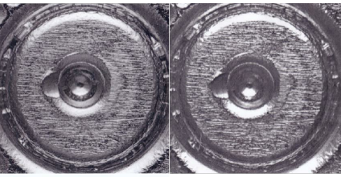
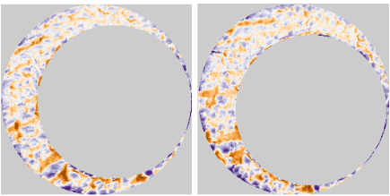

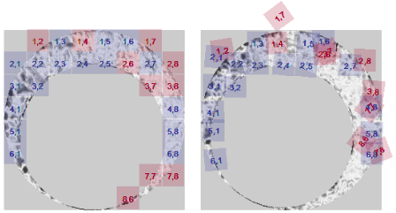
cmcR *Pipe*line
Initial Data %>%
Pre-processing %>%
Comparison %>%
Final Results
preProcess_crop() %>%
Cartridge Cases %>%
preProcess_removeTrend() %>%
comparison_allTogether() %>%
decision_CMC()
preProcess_gaussFilter() %>%
Notes:
On this slide, we have the same pipeline as introduced in the previous slides.
In cmcR, we have taken each part of this pipeline and broken them up into individual pieces, represented by the text in the middle of the slide.
First, we start with two cartridge cases, as shown in gray.
These cartridge cases are sent (represented by the pipe symbol)
Then, we perform some pre-processing on scans of those cartridge cases, as shown in orange.
We have divided this pre-processing stage into 3 steps which I won’t discuss due to time.
The result of the pre-processing is shown at the bottom of the slide.
Next, the scans are compared to each other, as represented in purple.
The comparison procedure is implemented in a function called comparison_allTogether().
Finally, the data obtained from the comparison procedure is sent to the Final Results stage in which particular cells are classified as “Congruent Matching Cells” or not.
The diagram at the bottom shows the final

Slide 9
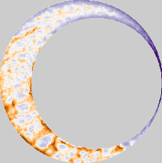
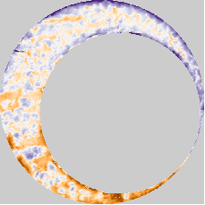
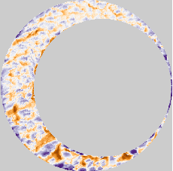
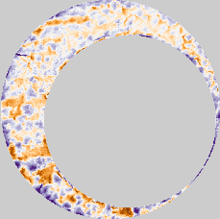
CMC Pipeline Experimentation
Modularization enables experimentation with particular steps
preProcess_crop() %>%
Cartridge Cases %>%
preProcess_removeTrend() %>%
comparison_allTogether() %>%
decision_CMC()
preProcess_gaussFilter() %>%
Trend Not Removed
Trend Removed
Scan 1
Scan 2
Scan 1
Scan 2
Notes:
For example, what happens if we skip the step where the trend is removed?
The figures below show the same pair of scans.
On the left, the global “tilt” or trend in the scans is not removed causing some values near the top-right to be lower, on average, than values in the bottom-left
On the right, this “tilt” has been removed.

Slide 10
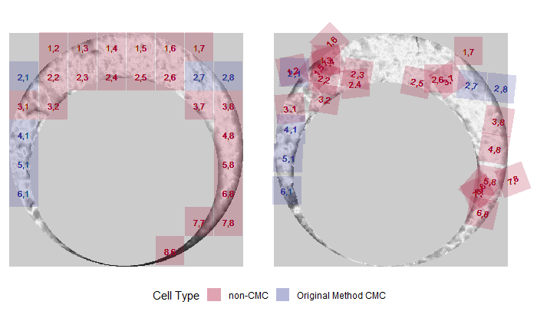
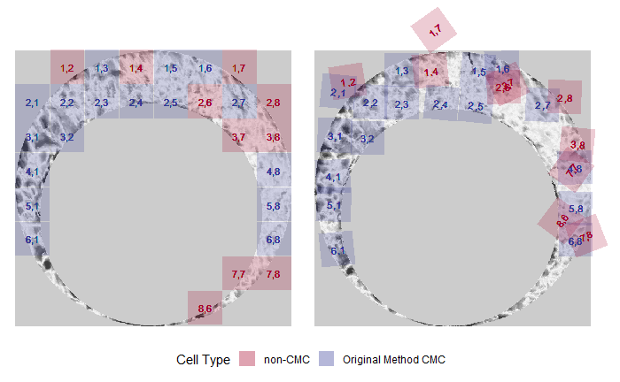
Example: How does removing the trend affect the CMC score?
Trend Not Removed
Trend Removed
Scan 1
Scan 2
Scan 1
Scan 2
Scan 1
Scan 2
Scan 1
Scan 2
6 CMCs
17 CMCs
Conclusion: Removing the trend increases the similarity score for this matching pair.
Notes:
Obviously, a single pair of scans is not sufficient to prove that particular step in the pipeline is warranted.
To justify the addition of a step, we must consider its use across many comparisons.
The next slide shows such results.

Slide 11
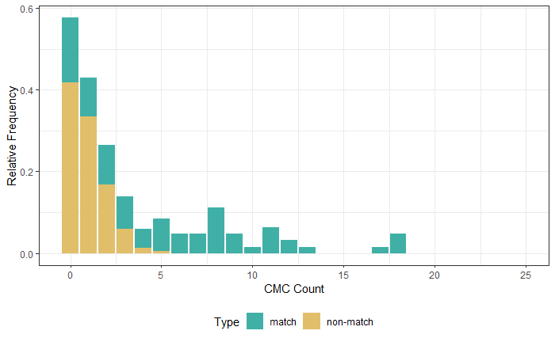
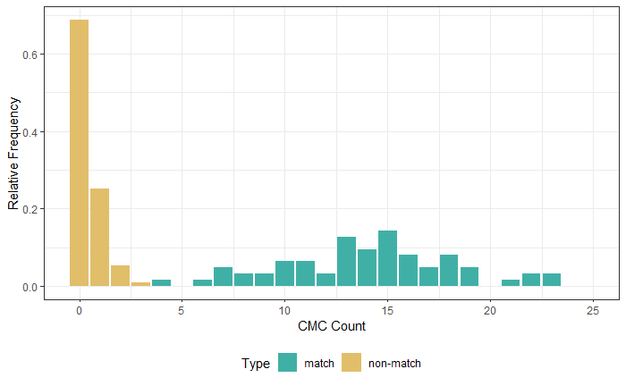
Example: How does removing the trend affect the CMC score?
Modularization eases experimentation across many scans
Consider 63 matching and 717 non-matching pairs:
Conclusion: Removing the trend increases the similarity score for many matching pairs.
Trend Not Removed
Trend Removed
Notes:
The results shown here indicate that removing the “tilt” to scans increases the CMC score for matching comparisons while decreasing the CMC score for non-matching comparisons, which is desired.
As such, these results suggest that removing the trend is a valuable addition to the overall pipeline.
This demonstrates how the modularization of the CMC algorithms makes experimentation easy

Slide 12
Summary
Algorithms are a useful tool for comparing forensic evidence.
The CMC algorithms measure the similarity between two cartridge cases based on their breech face markings.
Open-source algorithms enable others to reproduce results.
Modularizing the CMC pipeline into individual steps makes it easier to understand and experiment.

Slide 13
Resources
cmcR Source Code: https://github.com/CSAFE-ISU/cmcR
Email: jzemmels@iastate.edu
NIST Database: https://tsapps.nist.gov/NRBTD/Studies/Search
An Introduction to R: https://intro2r.com/
R for Data Science: https://r4ds.had.co.nz/

Slide 14
References
Song (2013)
Fadul et al. (2011)
R Core Team
cmcR package
An Introduction to R
R for Data Science

Slide 15
Thank You!
Questions?

